Slide 1

PHONE DATA EDA

Slide 2
Libraries used
Pandas
Numpy
Matplotlib
Seaborn
Sklearn
Train_test_split
Random_Forest_Classifier
GridSearch_CV
Pipeline

Slide 3
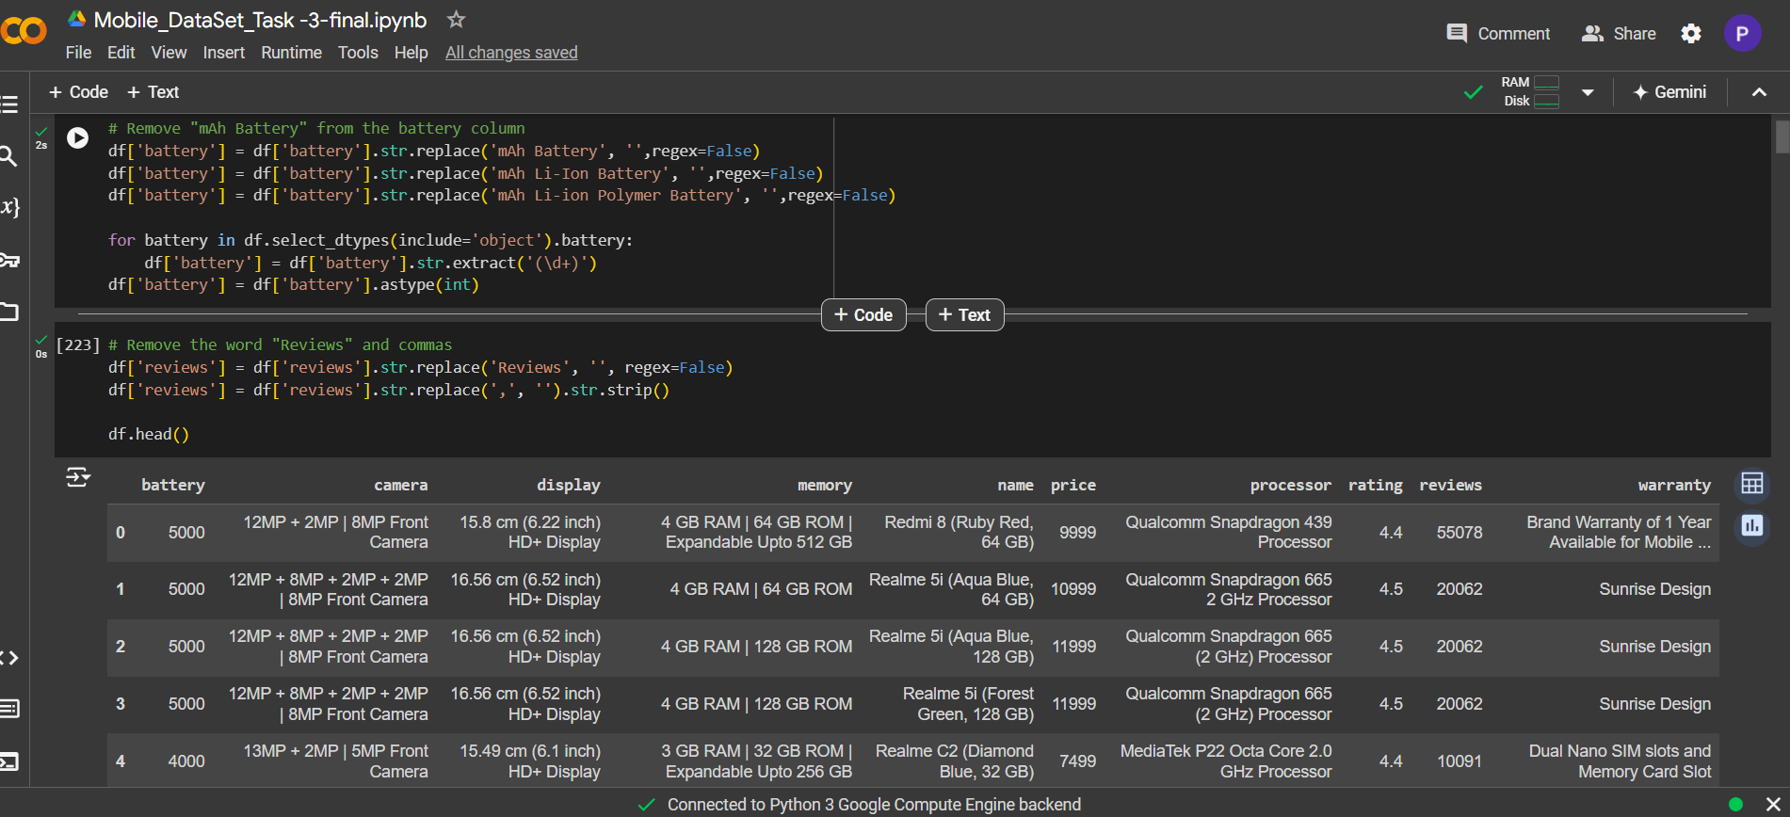
Pre-Processing

Slide 4
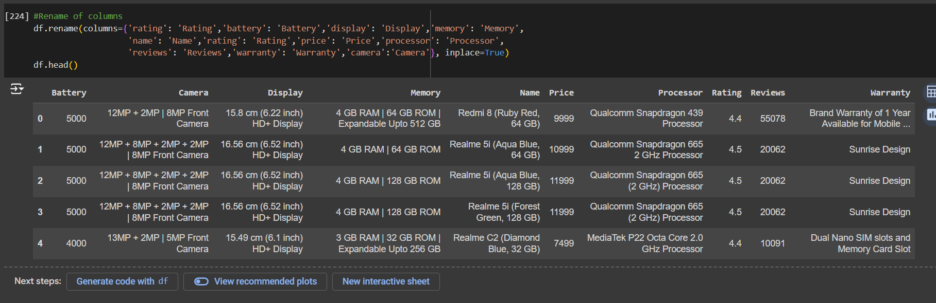
Renaming the Column Name

Slide 5
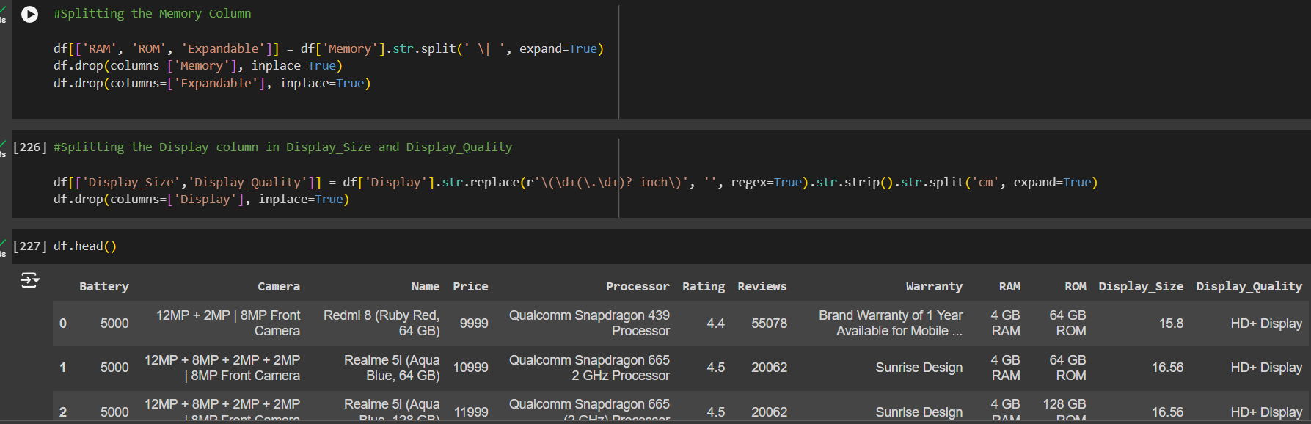
Splitting the Column

Slide 6
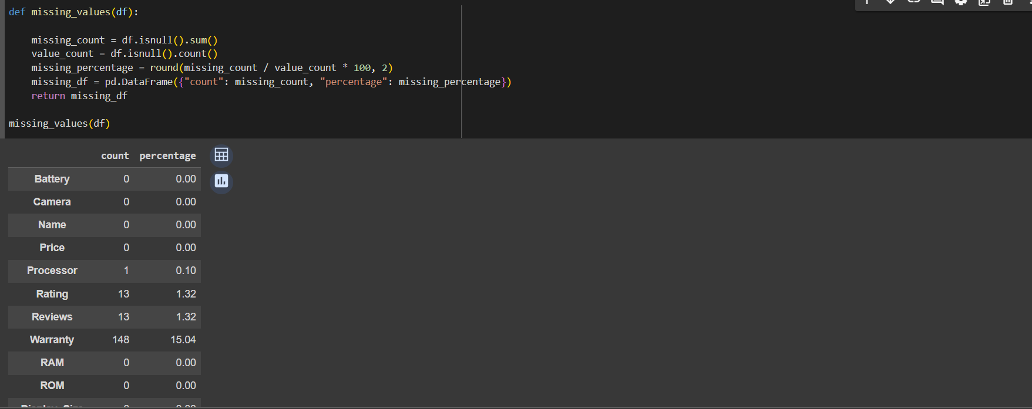
Finding the missing values

Slide 7
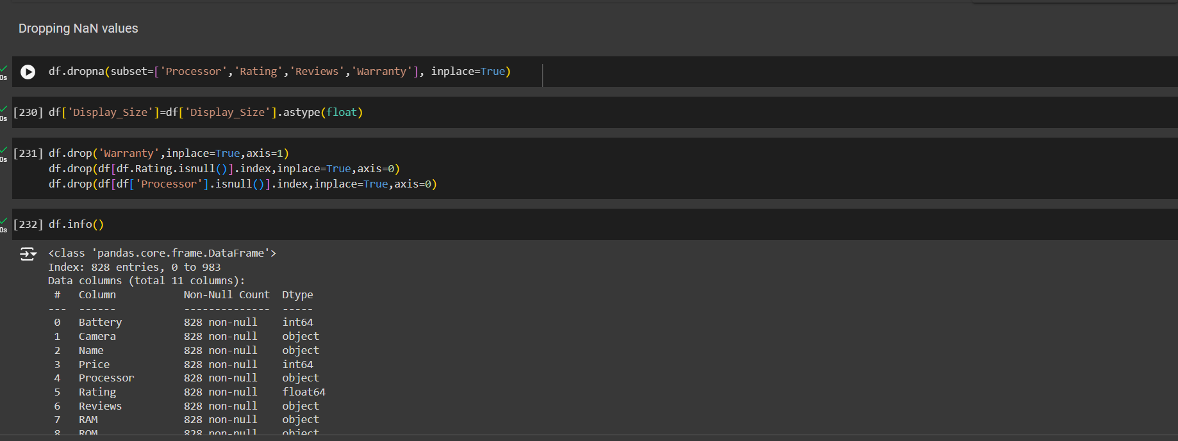
Dropping the NaN values

Slide 8
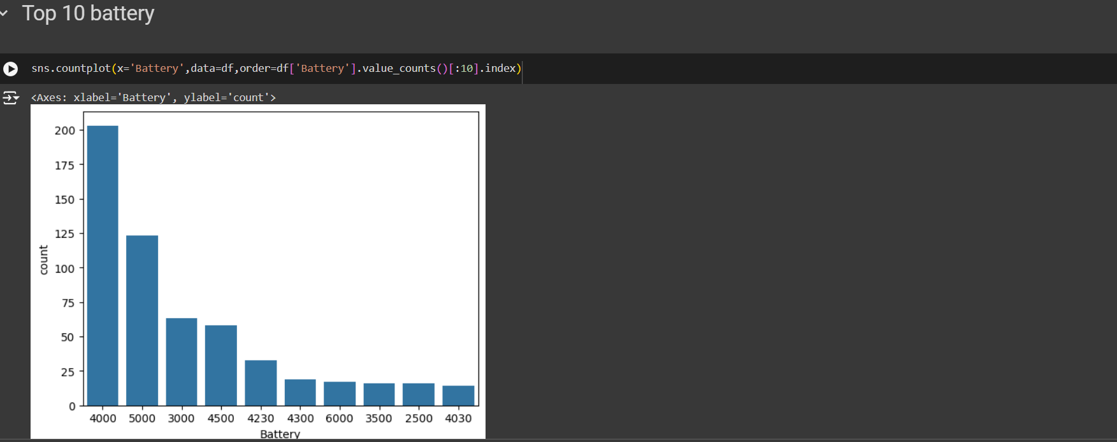
Univariate Analysis
Top 10 Phones by battery

Slide 9
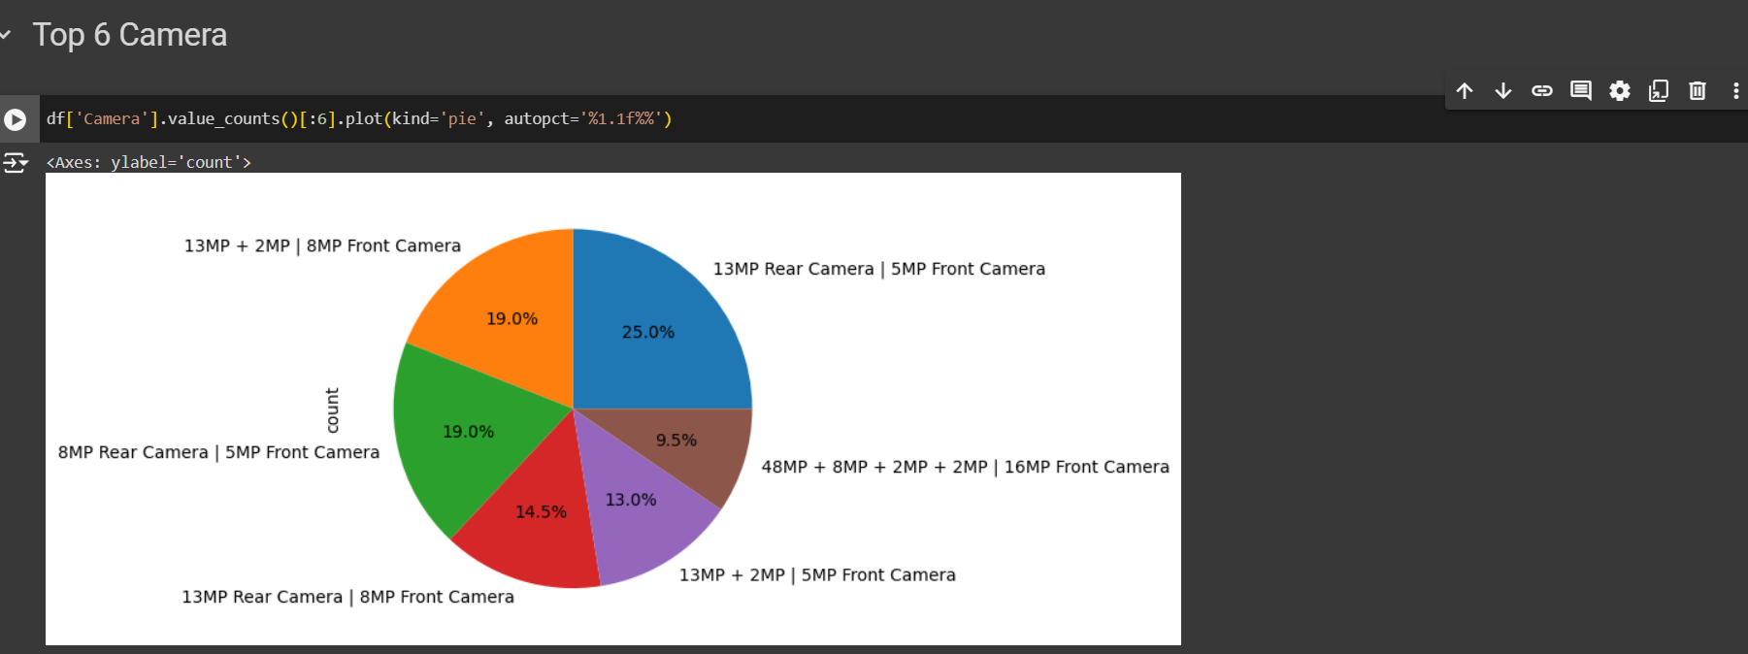
Top 10 Phones by Camera

Slide 10
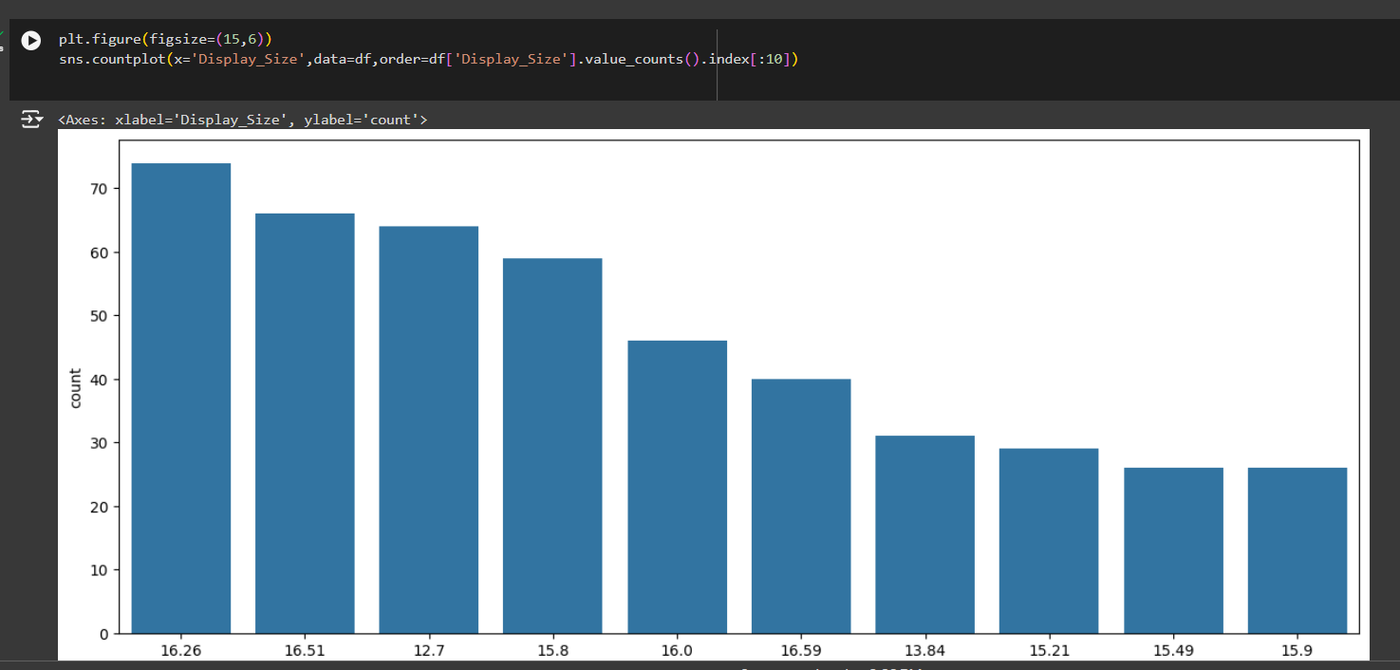
Top 10 Phone by Display Size

Slide 11
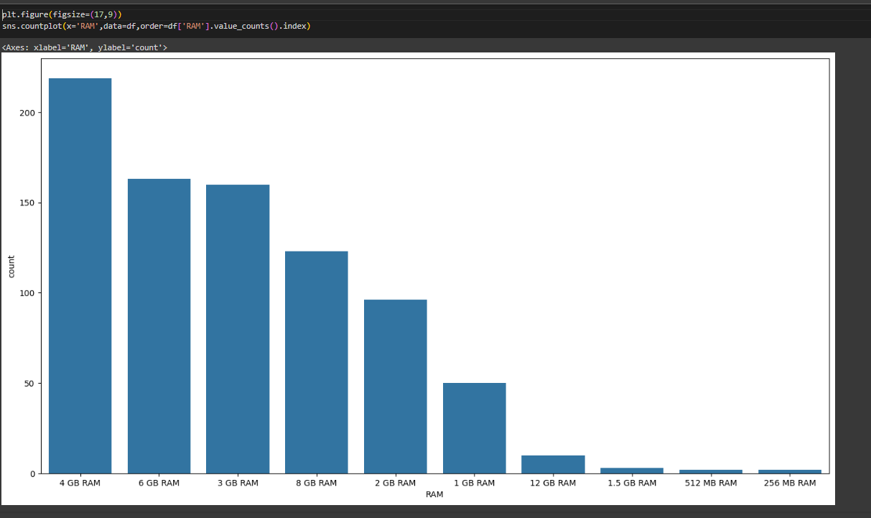
Top 10 Phones by RAM

Slide 12
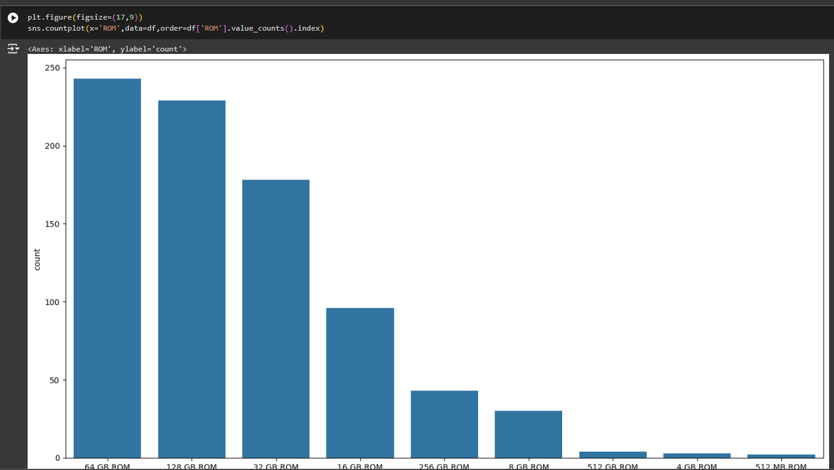
Top 10 Phones by ROM

Slide 13
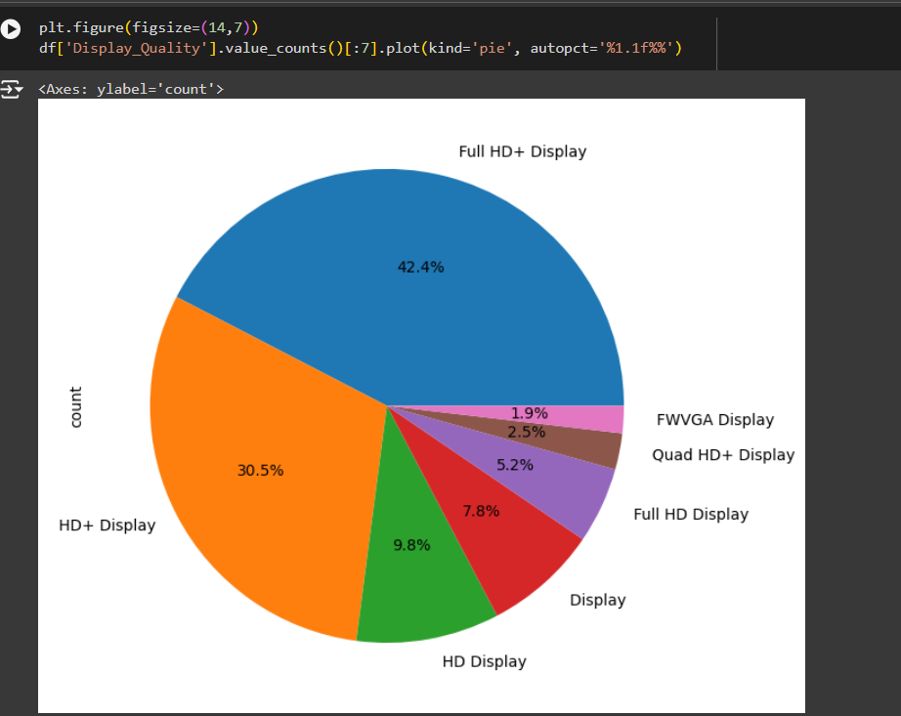
Top 10 Phones by Display

Slide 14
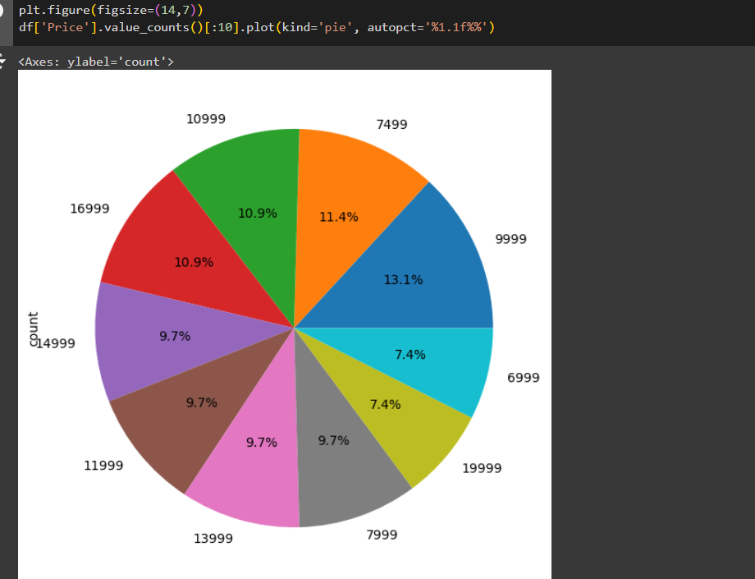
Top 10 Phones by Pricing

Slide 15
Bivariate Analysis

Slide 16
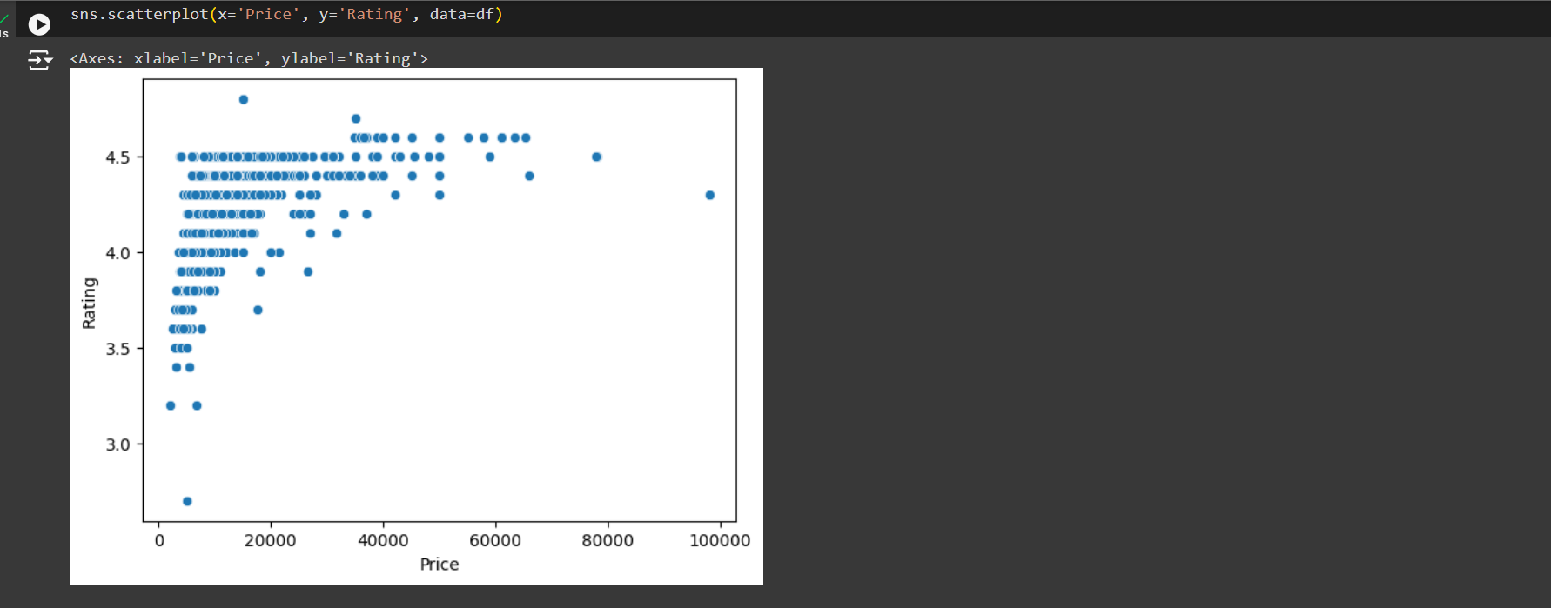
Comparing bivariate analysis on Price and Rating

Slide 17
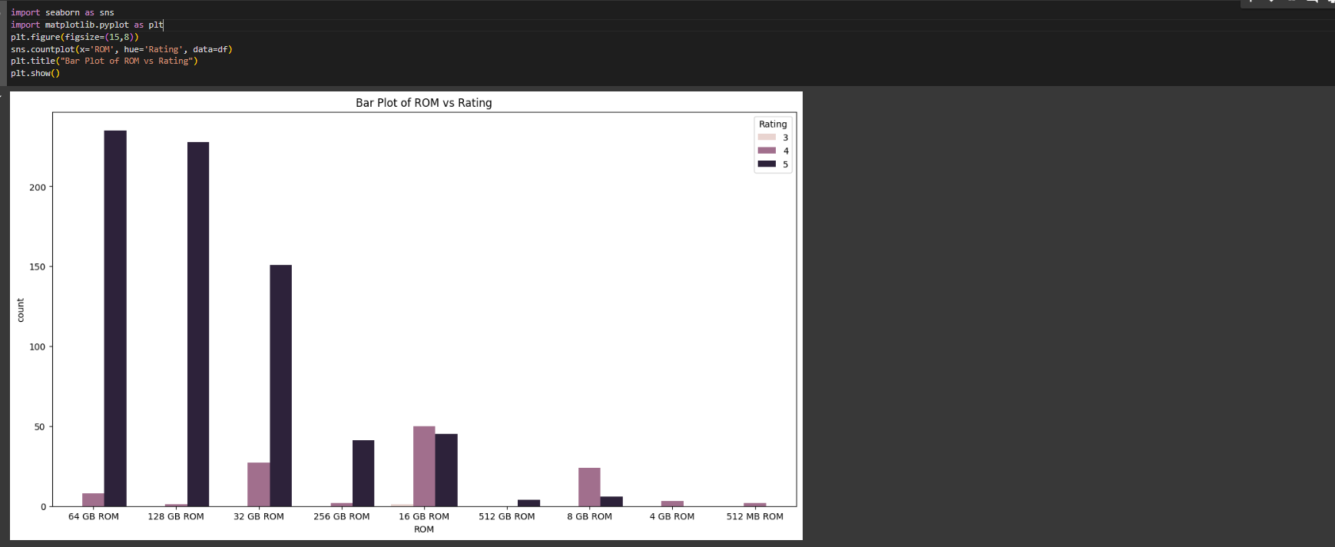
Comparing bivariate analysis on ROM and Rating

Slide 18
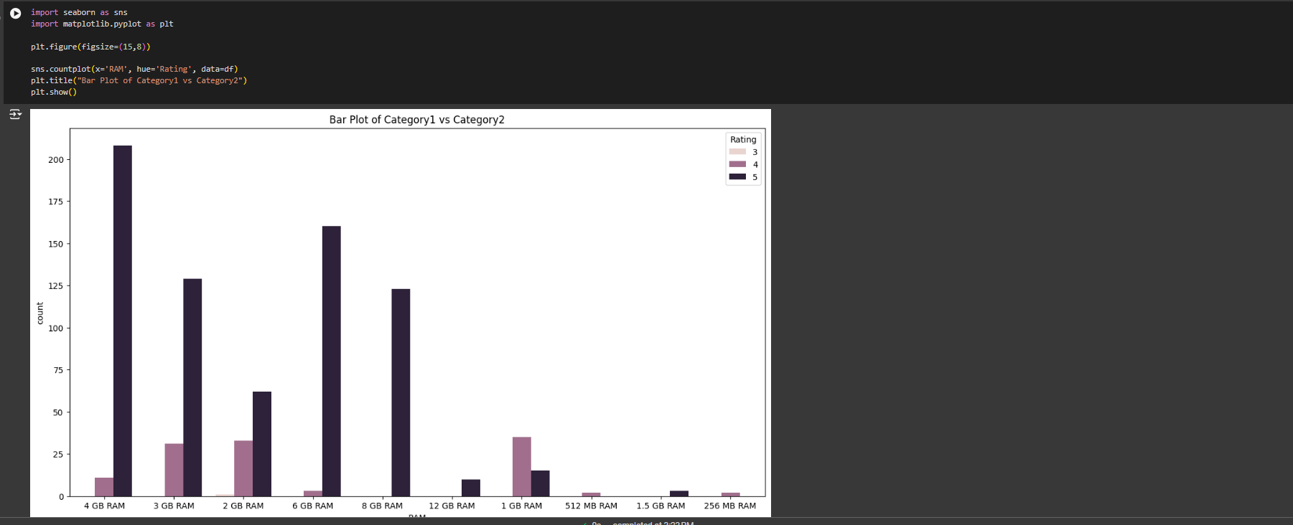
Comparing bivariate analysis on RAM and Rating

Slide 19
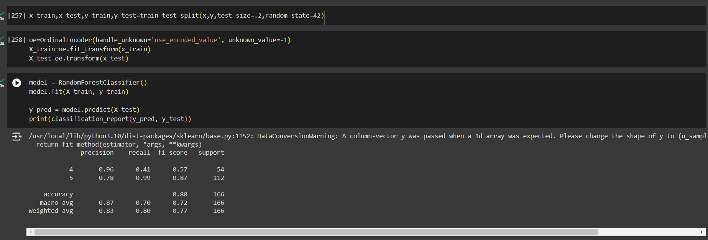
Train-test Splitting the model and getting accuracy score

Slide 20
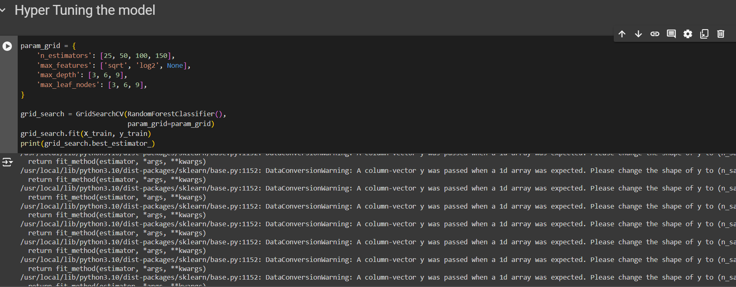
Fine Tunning the model

Slide 21
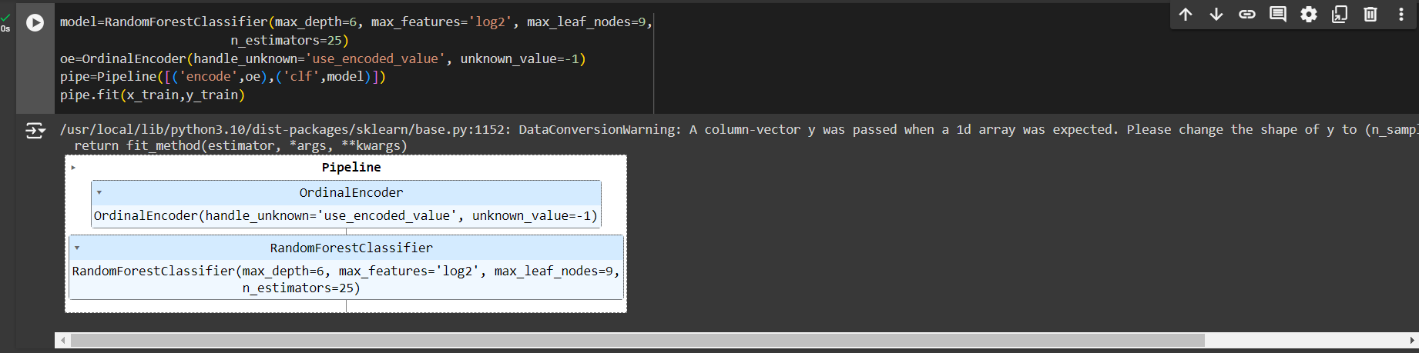
Making Pipeline

Slide 22
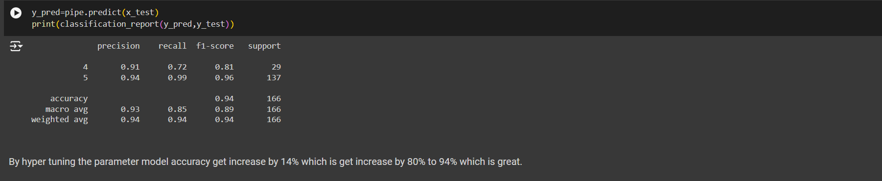
Again finding the accuracy after fine tunning

Slide 23
THANK YOU

